Slide 1
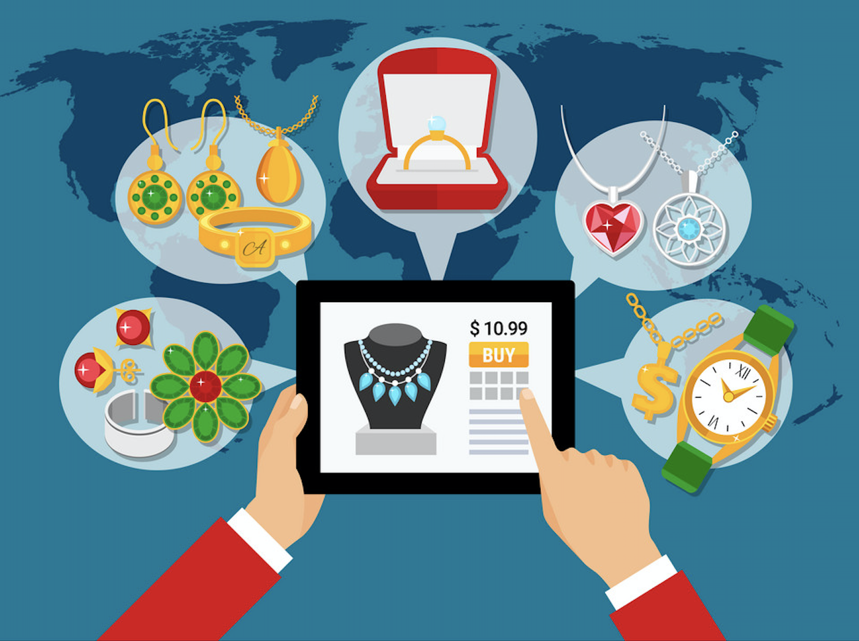
Buy Online Pickup In Store
Ayushi Choudhary
Bharati Malik
Pragyan Sharma
Sonal Agrawal
Swati Kwatra

Slide 2
Index
Business Context
Research Question
Data Overview
Analysis
Insights
Recommendations
Limitations
Appendix

Slide 3



Business Context: Why Buy Online Pickup In Store?
BOPS WIN-WIN SITUATION!
Save Shipping cost & time
Best of both
the worlds
Increase Sales
by reducing lost opportunities
Retailer
Compete with
large online players
Saves Time
Customers
Saves Money
Efficient Return Management
Happy
Customers
Cross Selling Increases
In-store Sales
Notes:
Win-Win phenomenon for customer and retailer!
-Best of both the worlds: Customers can use the online channel to do research, read reviews, compare prices, make payment and then pick the product from a store nearby. They no longer have to wait for the product to arrive in few days.
-Saves Time: BOPS save a lot time for customers, they no longer have to visit brick-and-motor store to get their hands on the product or wait for days for the product to arrive via shipment.
-Saves Money: Customers no longer will have to pay the high shipping charges associated with same day shipping or otherwise. They can pick up their order from the store of their choosing at their convenience.
-Efficient Return Management: With BOPS, customers enjoy the convenience and security of knowing that they can return the product on the spot if it does not suit their needs. Retailers also benefit from this as returns otherwise is an expensive process which they have to pay from their own pocket.
-Happy Customers: Most customers, sometime or the other, have surely faced instances when they did not receive their order on time. An advantage of buy online and pickup in store is that customers are only a drive away from getting their hands on the product. This can be a boon for customers who make last minute purchases.
-Cross Selling Increases In-store Sales: It gives retailers an opportunity to cross sell and up sell products to customers when they come to pick up their order.
-Increase Sales by reducing lost opportunities: A customer wants to purchase a product online but is out of stock and the same product is available in physical store close to customer’s location. With having online and offline systems talking to each other there is a way to figure how to convert it into sale and stop the customer to move over to competitor.

Slide 4
Business Context: BOPS Application for a Jewelry Brand
Online jewelry transactions between August 1st, 2010 and July 31st, 2013.
Implementation of BOPS on three online channels with store number 2, 6 and 5998.
BOPS IMPLEMENTATION TIMELINE
1
2
3
No
BOPS
BOPS
Implemented
BOPS
Implemented
Aug 1, 2011
Sep 27, 2012
Aug 1, 2010
All channels
Channel
2 and 6
Channel
2, 6 and 5998
Notes:
- There are three online channels. Store number for these channels are 2, 6, and 5998.
- Online channels 2 and 6 started the BOPS strategy on August 1st, 2011.
- Online channel 5998 started the BOPS strategy on September 27th, 2012.

Slide 5
Research Question
What is the impact of implementing BOPS on
Overall online channel sales and return ?
Online customer purchase and return behavior?
Product level sales and returns ?

Slide 6
Data Overview
Bops_in_effect
BOPS
Product_
category
Bops_
user
Time period BOPS is
1: Available
0: Not
Key data of interest
Sales Quantity
Sales Value
Return Quantity
Return Value
Purchase by
1: BOPS
0: Home delivery
Customer uses Bops when available
1: Yes 0: No
Store_
number
21 products such as bridal, solitaires, beads, diamond fashion, specialized jewelry etc.
Unique online store ID

Slide 7
Analysis: Overall Channel Sales
Impact on Sales after BOPS Implementation
 | Sales ( in $ value) | Sales ( in quantity)
Overall Impact | 49.4% Decrease | 33.3% Decrease
Product Level Impact | 28.8 % Decrease | 31.66% Decrease
Overall sales value and quantity depicted counter intuitive* results with a decrease!
Likely reason: Knowledge of availability of product (jewelry - highly priced! ) in store location increases the inclination to see, trust and then buy products at that physical store, leading to increased physical store sales and decreased online sales.
Product level sales decrease is comparatively less and depicting a clearer picture!
Likely reason: Product category is explaining the variation in sales value and return value even better due to more sample observations.
Notes:
*Counter Intuitive to Conventional wisdom
Offering customers BOPS would increase online sales; BOPS purchase would counts as online revenue since shoppers pay through the website.

Slide 8



Analysis: Impact on Sales Value – Product Level
Basis the level of impact, we grouped these together in three broader categories – No Impact, Low Impact and High Impact.
Categories
Mens
Gold Earrings
Insight
Indicates that there is a low demand for these categories
Categories
Beads
Watches
Insight
Indicates that no trials required for these products categories
Categories-Low (<30%)
Solitaires, Semi-Precious, Diamond Solitaires Jewellery, Diamond Wedding Bands
Insight
Indicates that these are high priced categories when customers check the inventory status online and prefer to buy it in store.
Categories-High(>30%) Bridal, Gold Wed Bands, Diamond Fashion, Gold Chain Jewellery, Pre-owned, Sterling Silver
Insight
Indicates that these might be low priced categories where product quality is not the priority and prefer home deliveries.
No Impact(~0%)
Positive Impact
Negative Low Impact
Negative High Impact
Notes:
No impact: There is no change on sales value after BOPS implementation
Positive Impact: There is an increase in the sales value after BOPS implementation (so good for us!)
Negative High Impact: There is a more than 30% decrease in the sales value after BOPS implementation (so bad for us!)
Negative Low Impact: There is 30% or less decrease in the sales value after BOPS implementation (so bad for us!)
Categories - 1,2,3,4,5,9,11,12,13,14,20,21, were significantly impacted after BOPS implementation.

Slide 9
Analysis: Overall Channel Returns
Impact on Returns after BOPS Implementation
 | Return ( in $ value) | Return ( in quantity)
Overall Impact | 66.0% Decrease | 17.2% Decrease
Product Level Impact | 33.3% Decrease | 38.5% Decrease
Overall return quantity and value depicted a decrease, good for us!
Likely reason: Inventory information leading customers to visit their nearest store and then ordering online*, after ensuring satisfaction about value and durability --> leading to less returns.
Product level returns, comparatively showing less decrease.
Likely reason: Product category is explaining the variation in return even better due to more sample observations.
Notes:
*ordering online
Assumption that online jewelry website has significantly low prices, discounts and competitor price comparisons, leading the consumer to switch online after store visit.

Slide 10
Analysis: Impact on Return Value – Product Level
Basis the level of impact, we grouped these together in three broader categories – No Impact, Low Impact and High Impact.
Categories:
Semi Precious
Men’s
Gold Earrings
Insight:
There is low demand and low sales, so low returns
Categories:
Solitaires,
Diamond Fashion,
Watches,
Diamond Wedding Bands,
Sterling Silver
Insight:
Requires quality satisfaction check before purchase.
Categories:
Bridal,
Gold Wed Bands,
Gold Chain,
Bridal,
Beads,
Pre-owned
Insight: Indicates that sales value is less
Categories
Gold Wed Bands,
Diamond Solitaire Jewellery
Insight: Indicates these products are not meeting customer expectations.
No Impact(~0%)
Positive High Impact
Positive Low Impact
Negative Impact
Notes:
No impact: There is no change on return value after BOPS implementation
Positive High Impact: There is more than 50% decrease in the return value after BOPS implementation (so good for us!)
Positive Low Impact: There is a 50% or less decrease in the return value after BOPS implementation (so good for us!)
Negative Impact: There is an increase in the return value after BOPS implementation (bad for us!)
Categories – 1,2,3,4,9,11,12,13,14,20,21, were significantly impacted after BOPS implementation.

Slide 11
Analysis: Customer level analysis – Buying and Return Behavior
Buying Behavior
Impact on Sales of using BOPS Service
 | Sales Quantity | Sales Value
Bops User | 4.1% Decrease | 4.4% Decrease
A customer using BOPS service buys 4.1% less quantity and 4.4 % less sales value than a customer who doesn’t use BOPS service.
It is likely that a customer using BOPS has easy access to the store and might prefer to do most of the purchases in-store, given that the inventory information is now available.
Return Behavior
Return propensity of a customer who uses BOPS service is 36.9 PERCENTAGE POINTS more than a customer who doesn’t use BOPS Service.
Ease of return that comes with using BOPS service is a likely explanation of the higher probability of return behavior. If the product doesn’t match consumer’s expectation, they can initiate a return easily since they are already at store.

Slide 12
Insights and Recommendations
Currently, overall online sales is showing a decreasing trend after BOPS strategy implementation. Over a period:
Understand the CHANNEL SHIFT EFFECT, shift of customers from the online to the brick-and-mortar channel and the conversion of online customers to store customers.
Measure the true impact of BOPS by analyzing ONLINE AND PHYSICAL STORE SALES together.
Focus on products with positive impact on sales and less returns : BEADS and WATCHES.
Increase in return probability for online purchases: To reduce returns, ENHANCE BOPS EXPERIENCE.
Train in-store employees for a seamless BOPS execution; better customer experience.
Dedicated counters for BOPS pick-ups and related customer enquiries.
Online inventory should be in sync with in-store availability.
Satisfied customer testimonials on website (i.e. product quality, accept refunds and store pick up is hassle free).

Slide 13
Limitations
DISTANCE between customer’s residence and nearest pick-up store location.
More information required on STORE CHANNELS, currently limited to store number 2, 6 and 5998.
Information required for SHIPPING POLICY.
No information about physical store sales and returns for measuring BOPS true impact (CROSS-SELLING effect due to sales of additional products).

Slide 14
Appendix

Slide 15
Model – Question 1
salesquantity = $β0+β1\text{(}\text{BIE}\text{_}\text{timeline}\text{∗}\text{group}\text{_}\text{store})+$ $β2\text{month}\text{_}\text{dummy}+β3\text{avg}\text{_}\text{female}+ β4\text{avg}\text{_}\text{age}+β5\text{avg}\text{_}\text{income}+β\text{6}\text{avg}\text{_}\text{homeowner}$+ $β\text{7}\text{avg}\text{_}\text{childowne}$r
log(salesvalue)= $β0+β1\text{(}\text{BIE}\text{_}\text{timeline}\text{∗}\text{group}\text{_}\text{store})+$ $β2\text{month}\text{_}\text{dummy}+β3\text{avg}\text{_}\text{female}+ β4\text{avg}\text{_}\text{age}+β5\text{avg}\text{_}\text{income}+β\text{6}\text{avg}\text{_}\text{homeowner}$+ $β\text{7}\text{avg}\text{_}\text{childowne}$r
Model – Question 2
returnquantity = $β0+β1\text{(}\text{BIE}\text{_}\text{timeline}\text{∗}\text{group}\text{_}\text{store})+$ $β2\text{month}\text{_}\text{dummy}+β3\text{avg}\text{_}\text{female}+ β4\text{avg}\text{_}\text{age}+β5\text{avg}\text{_}\text{income}+β\text{6}$ log_salesquantity
log(returnvalue)= = $β0+β1\text{(}\text{BIE}\text{_}\text{timeline}\text{∗}\text{group}\text{_}\text{store})+$ $β2\text{month}\text{_}\text{dummy}+β3\text{avg}\text{_}\text{female}+ β4\text{avg}\text{_}\text{age}+β5\text{avg}\text{_}\text{income}+β\text{6}$ log_salesvalue
Model – Question 3
salesquantity = $β0+β1\text{(}\text{bops}\text{_}\text{in}\text{_}\text{effect}\text{∗}BOPS_user+$ $β2\text{purchase}\text{_}\text{time}\text{_}\text{period}+β3\text{store}\text{_}\text{number}+ β4\text{age}\text{_}\text{band}+β5\text{est}\text{_}\text{income}\text{_}\text{code}+β\text{6}\text{homeowner}$+ $β\text{7}\text{c}\text{hil}\text{d}$
log(salesvalue) = $β0+β1\text{(}\text{bops}\text{_}\text{in}\text{_}\text{effect}\text{∗}BOPS_user+$ $β2\text{purchase}\text{_}\text{time}\text{_}\text{period}+β3\text{store}\text{_}\text{number}+ β4\text{age}\text{_}\text{band}+β5\text{est}\text{_}\text{income}\text{_}\text{code}+β\text{6}\text{homeowner}$+ $β\text{7}\text{c}\text{hil}\text{d}$
Notes:
A

Slide 16
Model – Question 4
Initial Model:
Return = β0+β1 bops+ β2 logprice + β3 product_category+ β4 store_number+ β5 month_dummy + β6 year+ β7 est_income_code + β8 female + β9 age_band
Final Model:
Stage 1:
bops = ϒ0 + ϒ1 length_of_residence + ϒ2 child + ϒ3 logprice + ϒ4 product_category+ ϒ5store_number+ ϒ6 month_dummy + ϒ7 year+ ϒ8 est_income_code + ϒ9 female + ϒ10 age_band
Stage 2:
Return = β0+β1 bops*+ β2 logprice + β3 product_category+ β4 store_number+ β5 month_dummy + β6 year+ β7 est_income_code + β8 female + β9 age_band
Notes:
A

Slide 17
Model – Question 5
salesquantity = $β0+β1\text{(}\text{BIE}\text{_}\text{timeline}\text{∗}\text{group}\text{_}\text{store})+$ $β2\text{month}\text{_}\text{dummy}+β3\text{avg}\text{_}\text{female}+ β4\text{avg}\text{_}\text{age}+β5\text{avg}\text{_}\text{income}+β\text{6}\text{avg}\text{_}\text{homeowner}$+ $β\text{7}\text{avg}\text{_}\text{childowne}$r + $β\text{8}$ $\text{product}\text{_}\text{category}$
log(salesvalue)= $β0+β1\text{(}\text{BIE}\text{_}\text{timeline}\text{∗}\text{group}\text{_}\text{store})+$ $β2\text{month}\text{_}\text{dummy}+β3\text{avg}\text{_}\text{female}+ β4\text{avg}\text{_}\text{age}+β5\text{avg}\text{_}\text{income}+β\text{6}\text{avg}\text{_}\text{homeowner}$ + $β\text{8}$ $\text{product}\text{_}\text{category}$
returnquantity = $β0+β1\text{(}\text{BIE}\text{_}\text{timeline}\text{∗}\text{group}\text{_}\text{store})+$ $β2\text{month}\text{_}\text{dummy}+β3\text{avg}\text{_}\text{female}+ β4\text{avg}\text{_}\text{age}+β5\text{avg}\text{_}\text{income}+β\text{6}$ log_salesquantity + $β\text{8}$ $\text{product}\text{_}\text{category}$
log(returnvalue)= = $β0+β1\text{(}\text{BIE}\text{_}\text{timeline}\text{∗}\text{group}\text{_}\text{store})+$ $β2\text{month}\text{_}\text{dummy}+β3\text{avg}\text{_}\text{female}+ β4\text{avg}\text{_}\text{age}+β5\text{avg}\text{_}\text{income}+β\text{6}$ log_salesvalue + $β\text{8}$ $\text{product}\text{_}\text{category}$
Model – Question 6
log(salesvalue)= $β0+β1\text{(}\text{BIE}\text{_}\text{timeline}\text{∗}\text{group}\text{_}\text{store}\text{∗}\text{product}\text{_}\text{category})+$ $β2\text{month}\text{_}\text{dummy}+β3\text{avg}\text{_}\text{female}+ β4\text{avg}\text{_}\text{age}+β5\text{avg}\text{_}\text{income}+β\text{6}\text{avg}\text{_}\text{homeowner}$+ $β\text{7}\text{avg}\text{_}\text{childowne}$r
log(returnvalue)= = $β0+β1\text{(}\text{BIE}\text{_}\text{timeline}\text{∗}\text{group}\text{_}\text{store}\text{∗}\text{product}\text{_}\text{category})+$ $β2\text{month}\text{_}\text{dummy}+β3\text{avg}\text{_}\text{female}+ β4\text{avg}\text{_}\text{age}+β5\text{avg}\text{_}\text{income}+β\text{6}$ log_salesvalue
Notes:
A

Slide 18
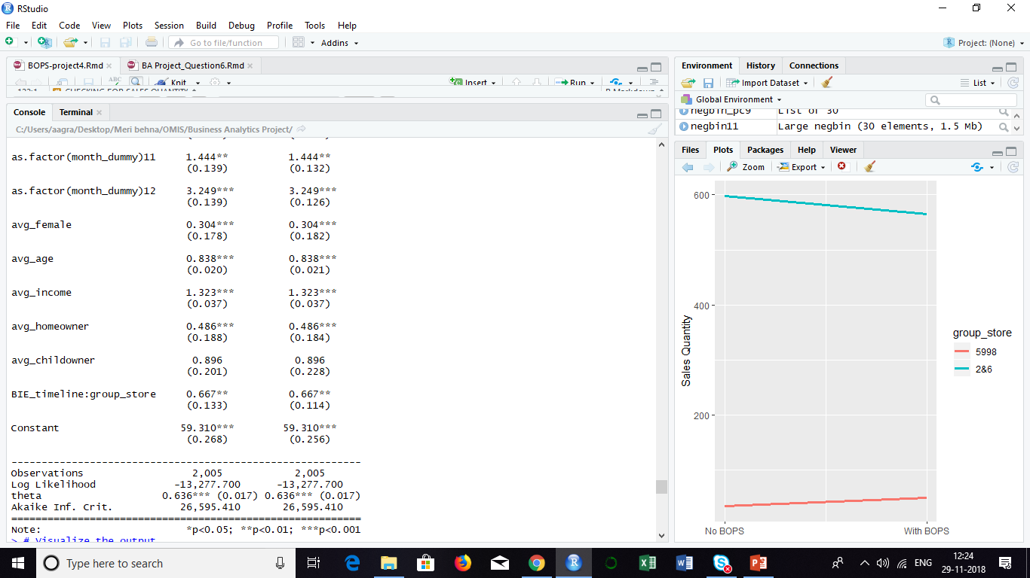
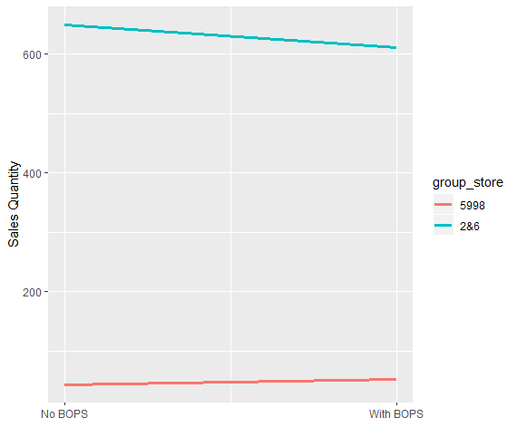
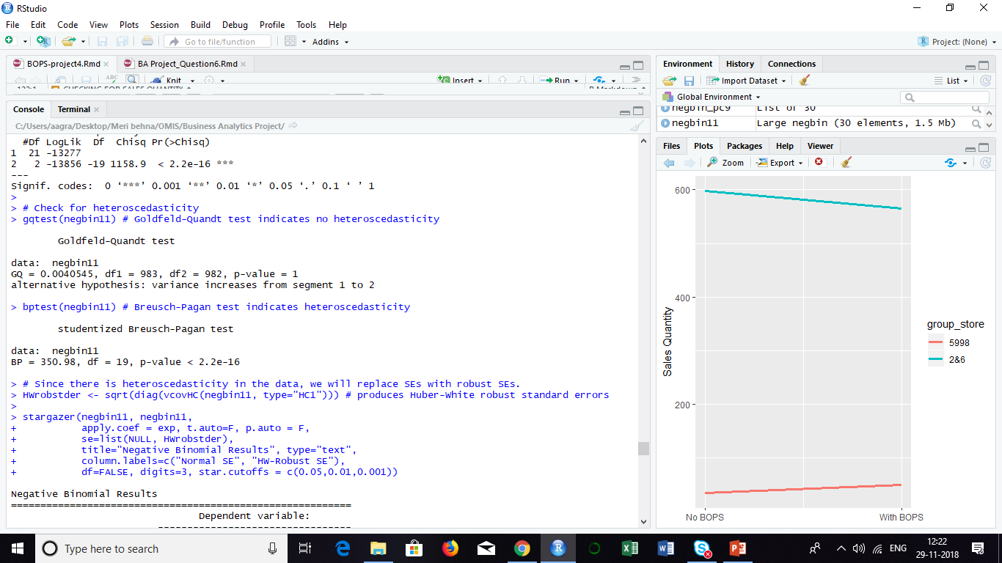
Impact of BOPS on Online Sales Quantity
Sales Quantity

Slide 19
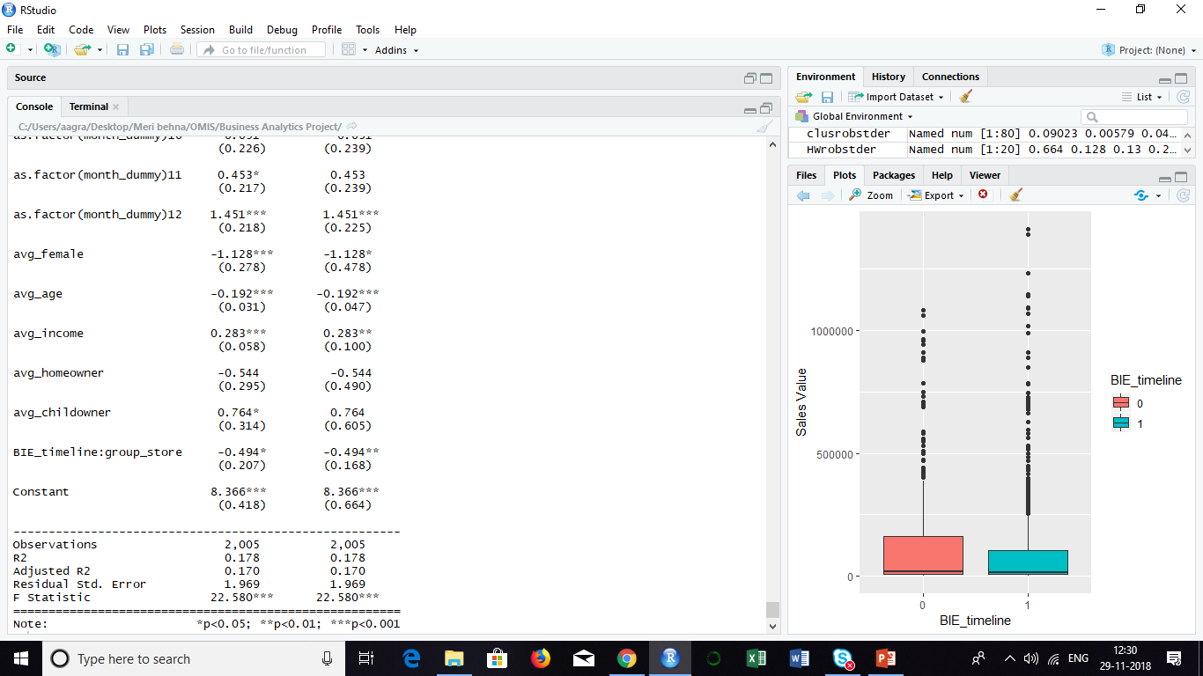
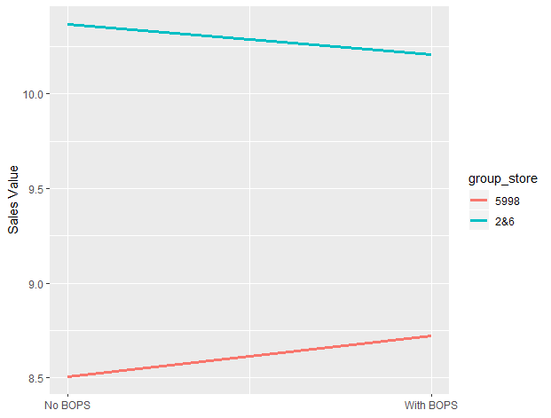
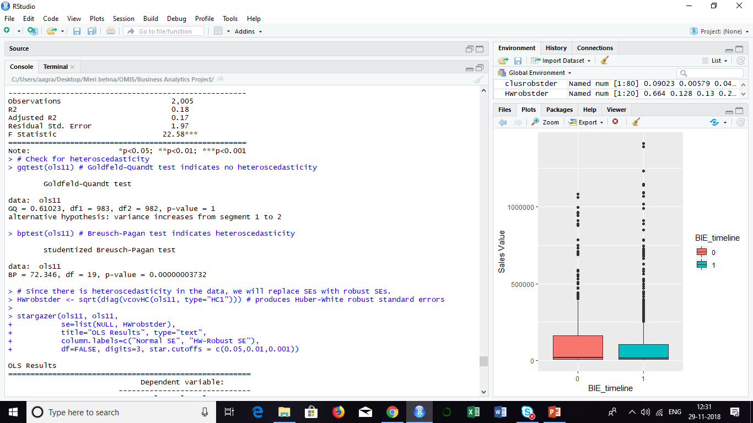
Impact of BOPS on Online Sales Value
Sales Value

Slide 20
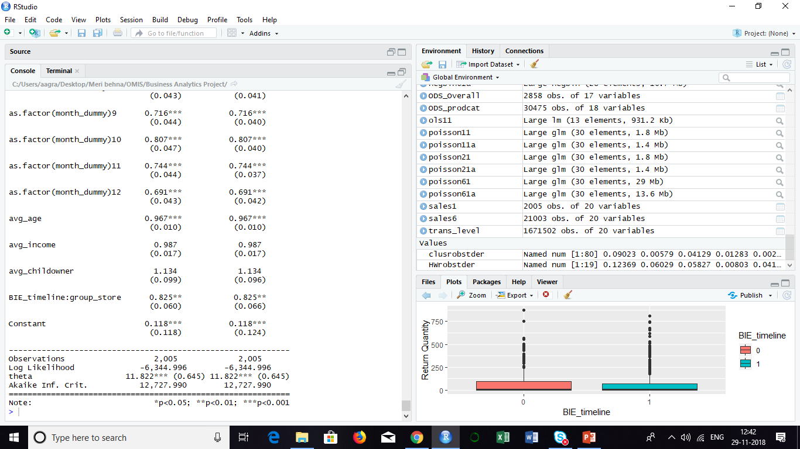
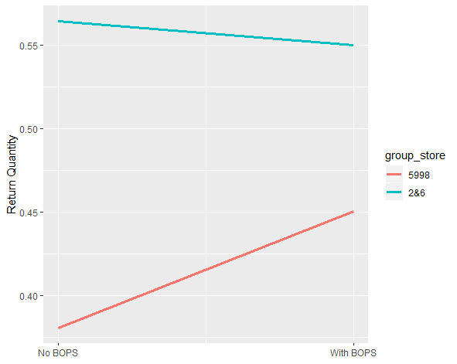
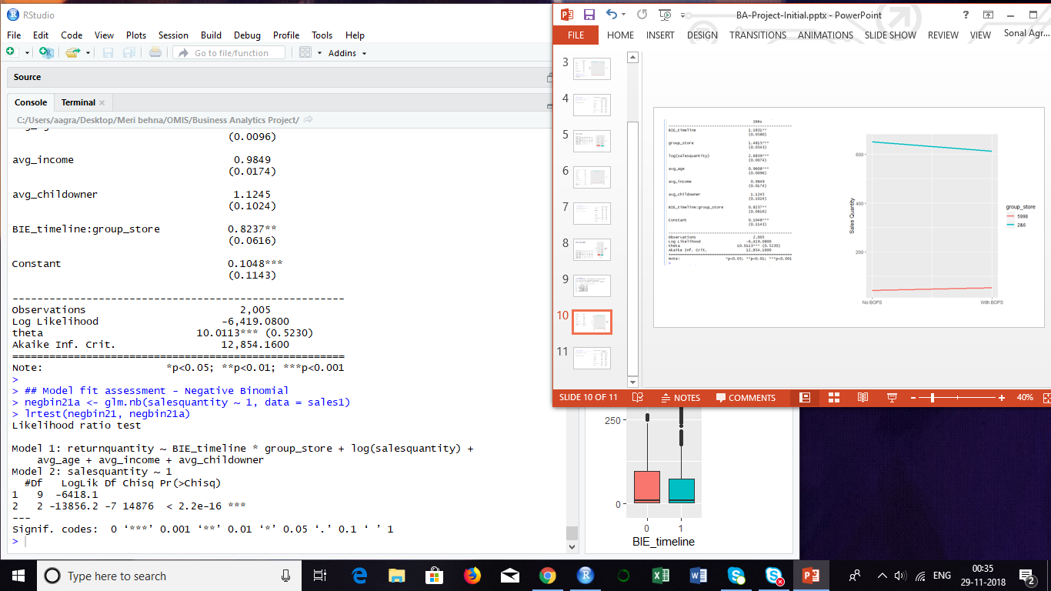
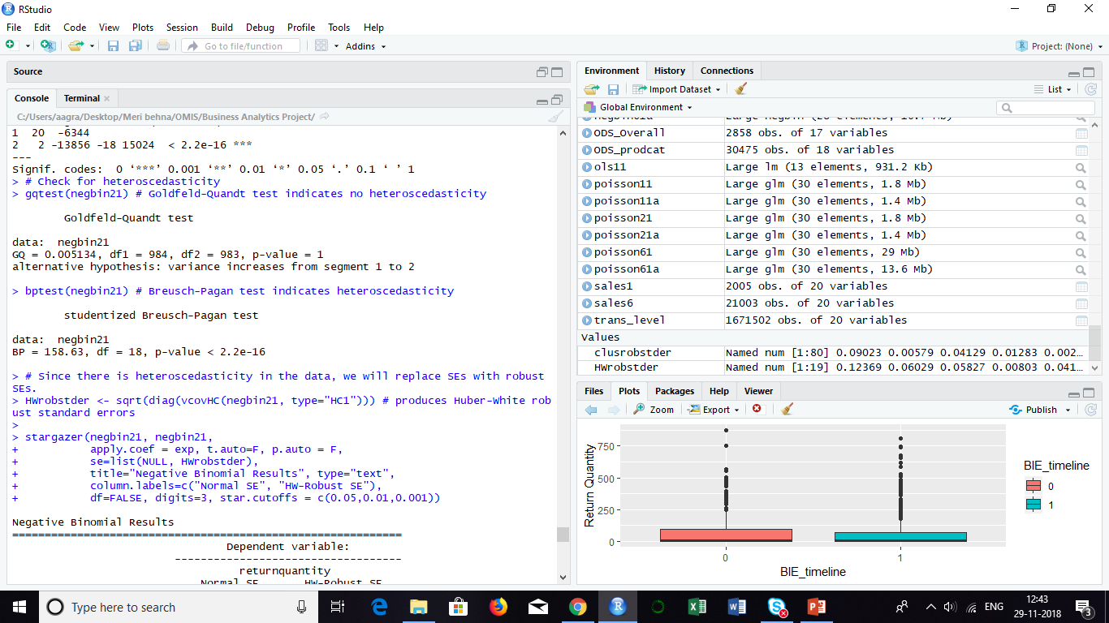
Impact of BOPS on Online Return Quantity
Return Quantity

Slide 21
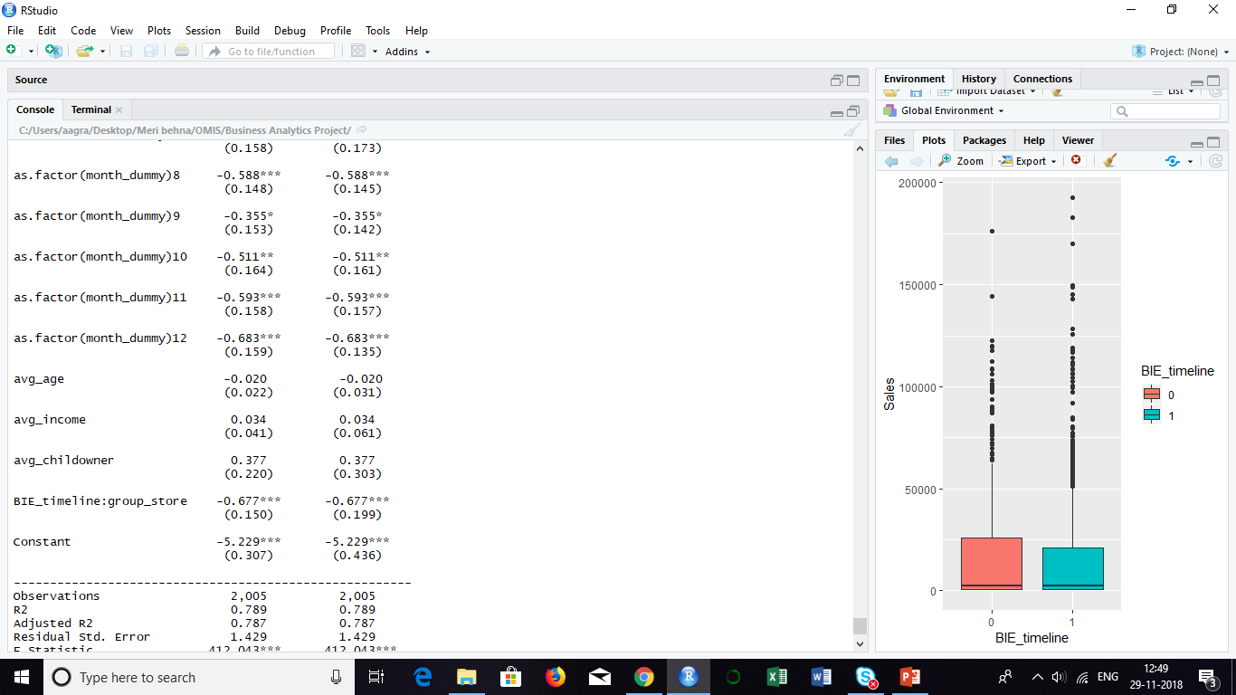
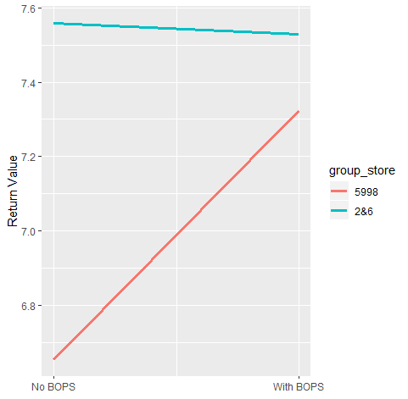
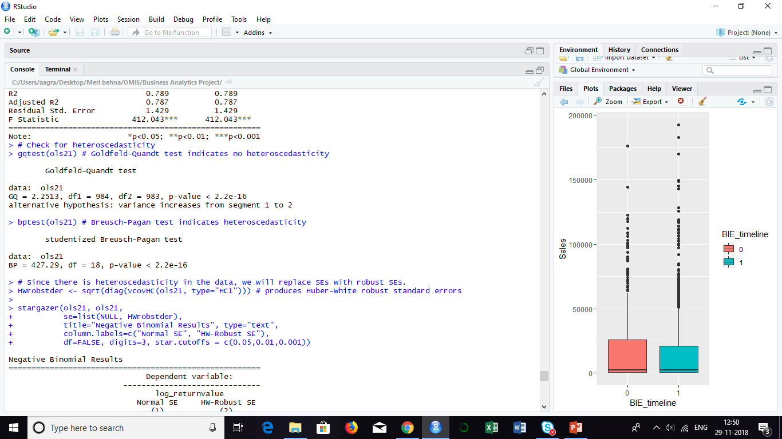
Impact of BOPS on Online Return Value
Return Value

Slide 22
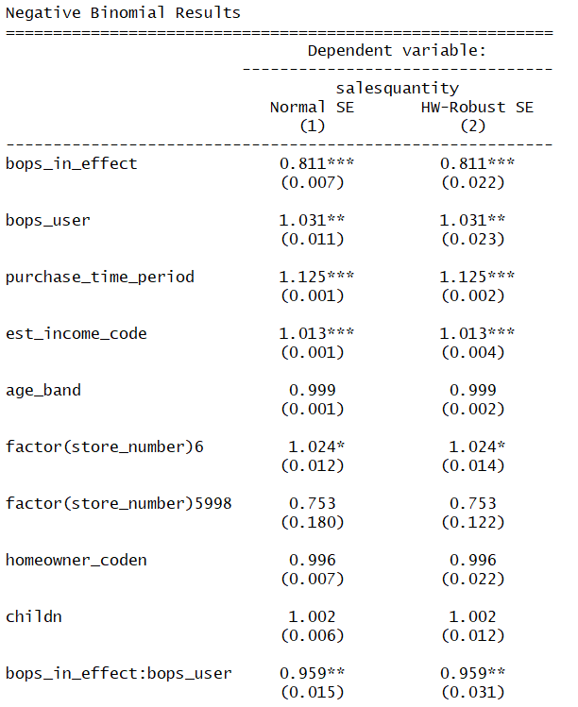
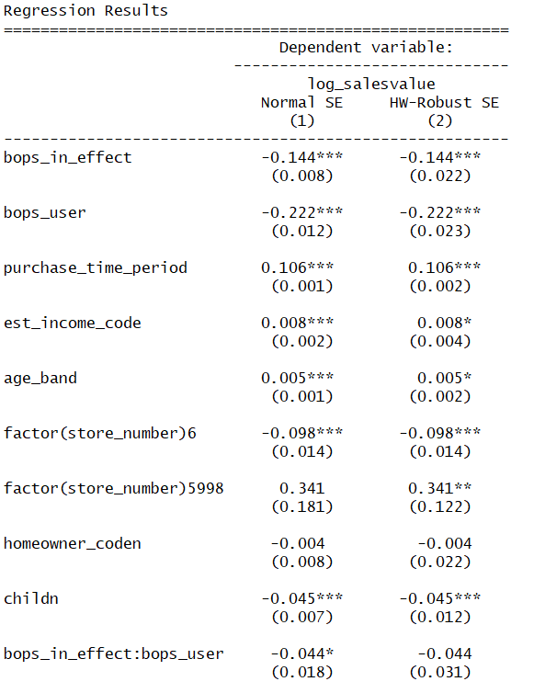
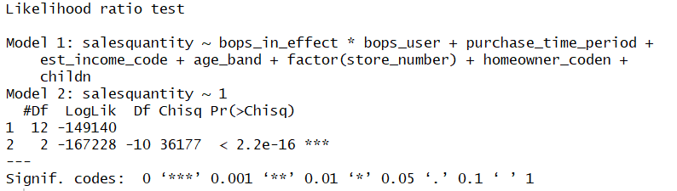
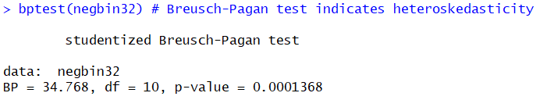
Customer level analysis – Purchase Behavior
Notes:
Notes: We used negative binomial to model sales quantity and OLS model for sales value.

Slide 23
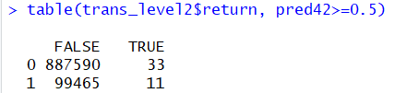
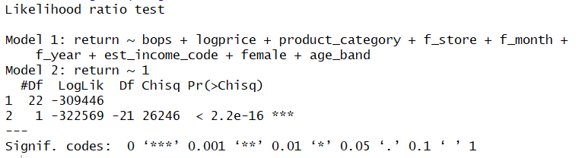
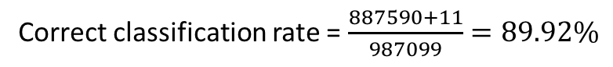
Customer level analysis – Return Behavior
Logit Model Highlights
Return Prediction
Return: Logit Ratio
Classified based on return | True Value |  | Total
 | 0 | 1
0 | 887590 | 33 | 887623
1 | 99465 | 11 | 99476
Total | 987055 | 44 | 987099
Return | Count | Number of independent variable | Ratio | Satisfies the 10:1 requirement
1 (Yes) | 99476 | 21 | 99476/21 | Yes
0 (No) | 887623 | 21 | 887623/21 | Yes
Correct classification rate = $\frac{887590+11}{987099}=89.92\%$
Notes:
Notes: Since return is a binary outcome variable, we started with logit model.

Slide 24
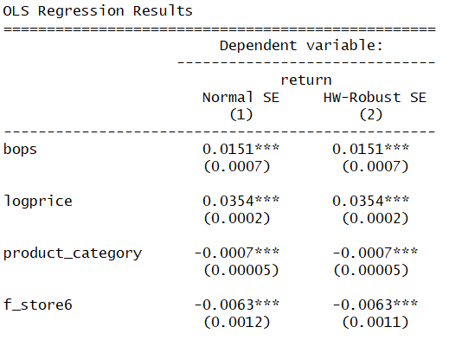
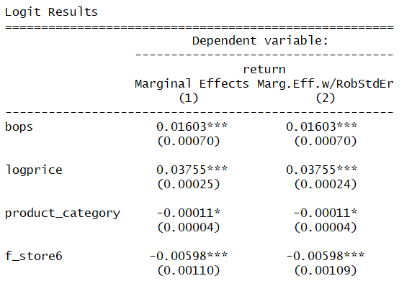
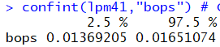
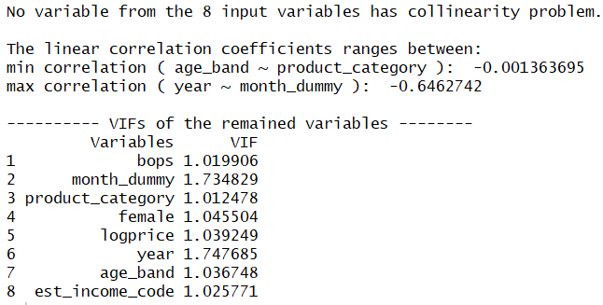
Customer level analysis – Return Behavior
Since using BOPS is a customer's decision, we suspect that key independent variable is Endogenous
Omitted Variable: Proximity
Endogenous Variable: BOPS
Instrument Variables:
Length of Residence
Child
*Results of OLS model and Logit models are comparable
Notes:
Notes:
Instrument Variables –
Relationship with key independent variable:
1. Length of residence is the number of years a customer has lived on his/her current residence. The higher the number of years the customer has lived in his residence, the more familiar he is with the stores around and is more likely to use BOPS.
2. Child - For a customer with a child, using BOPS service would create a hassle for the customer to go to store and thus we suspect that child variable is negatively correlated with BOPS.
Relationship with dependent variable:
Conceptually, Child and Length of residence do not explain any variation on return of jewelry items.

Slide 25
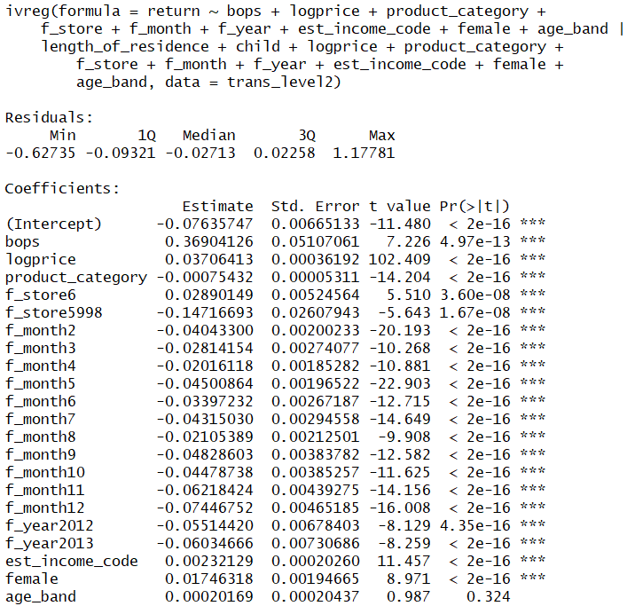
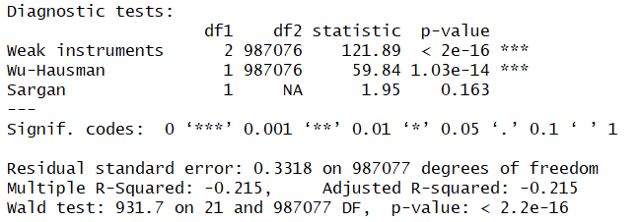
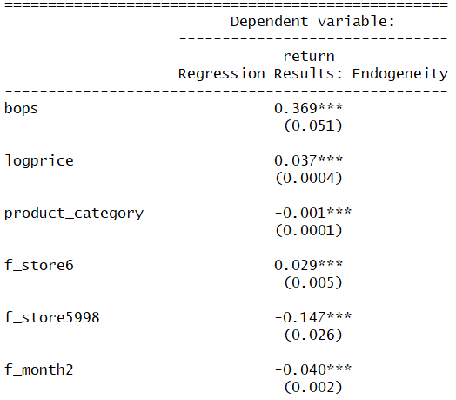
Customer level analysis – Return Behavior
2SLS model to treat Endogeneity
Notes:
Interpretation:
After treating endogeneity in our model, the coefficient for BOPS in 2SLS model is 0.369. This means that a BOPS user is 36.9 percentage points more likely to return a jewelry item. Since the results from our OLS and Logit models were similar, we are proceeding with 2SLS results.

Slide 26
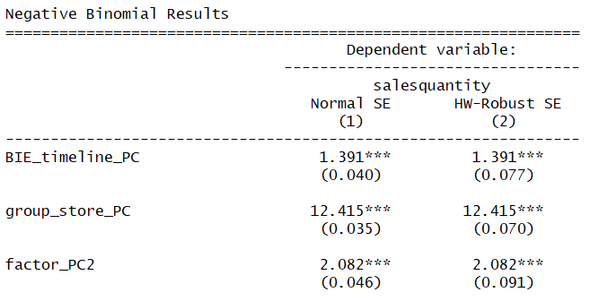
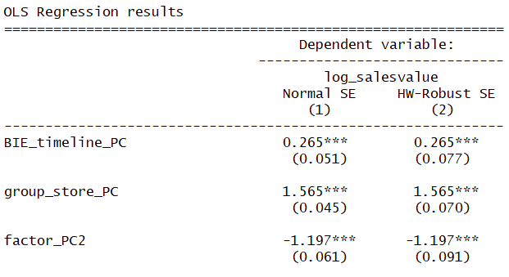
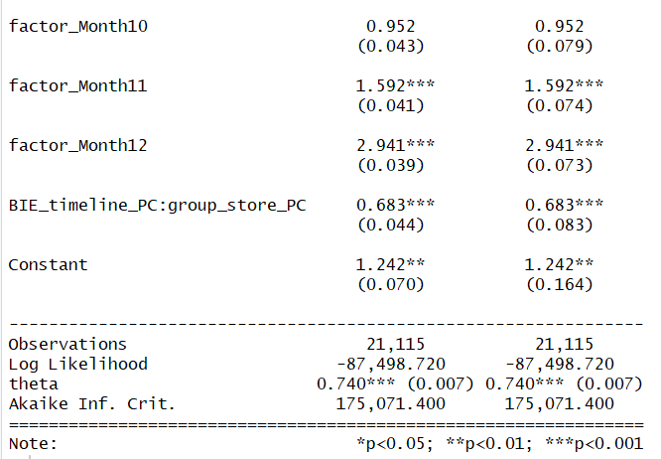
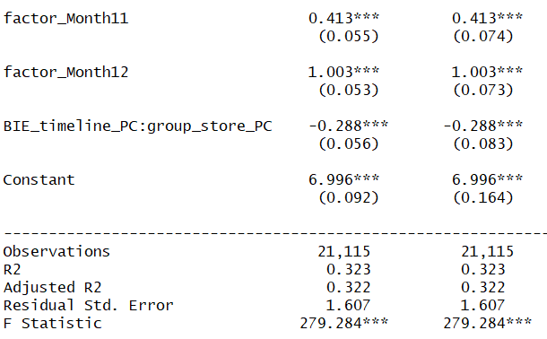
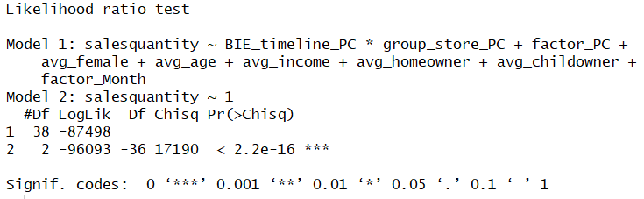
Analysis: Product level – Sales

Slide 27
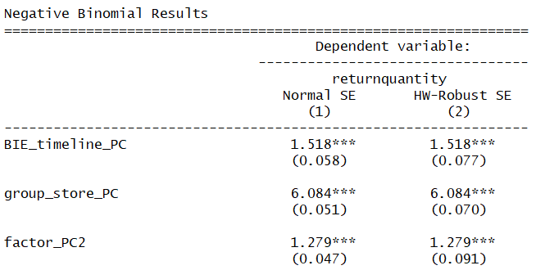
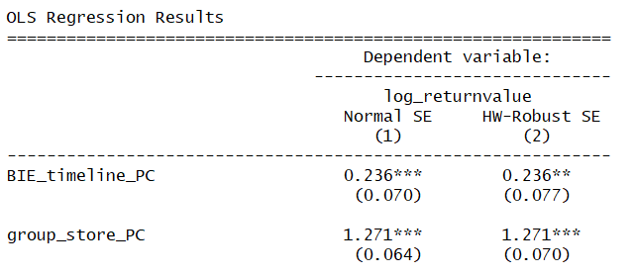
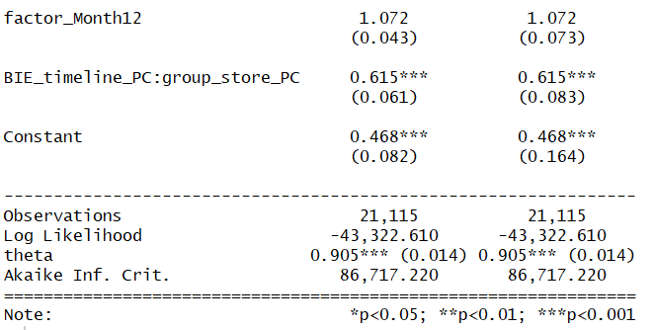
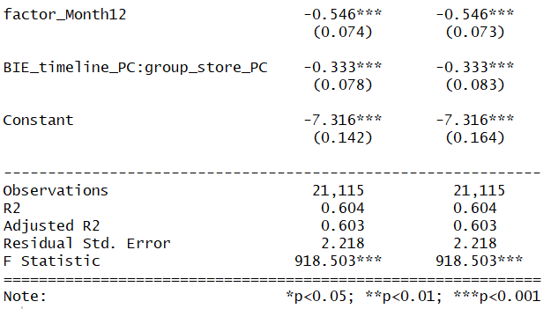
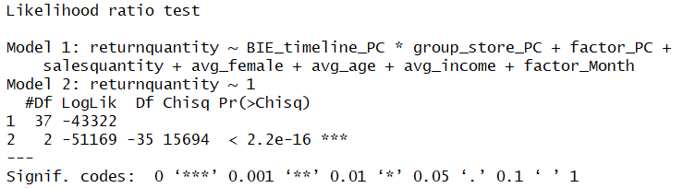
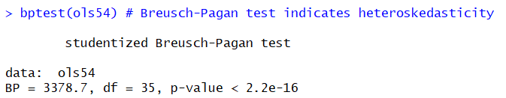
Analysis: Product level – Returns

Slide 28
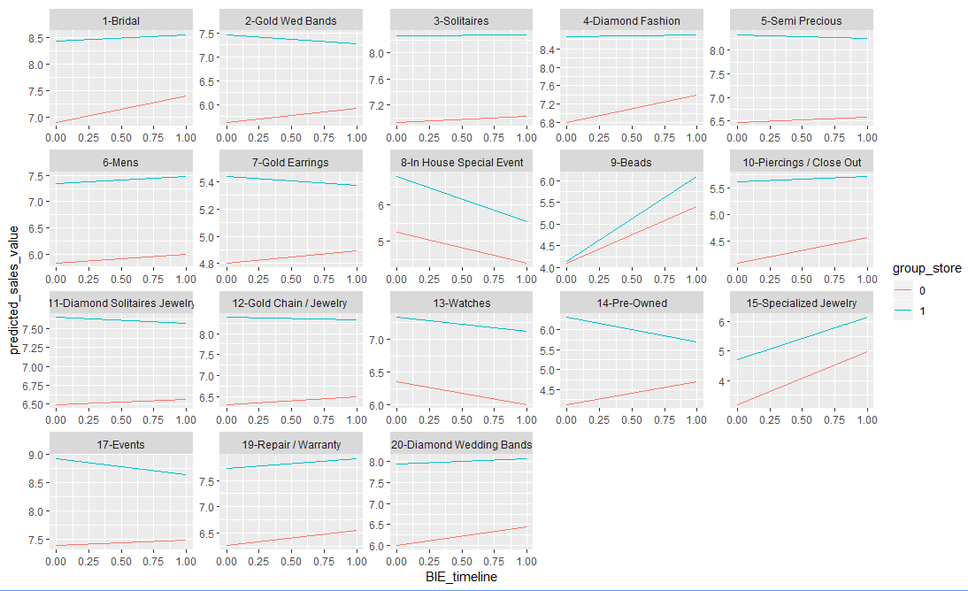
Online Sales– Product Level
Product Category | Increase/ Decrease
1 | - 31.3% ***
2 | - 38.8% ***
3 | - 6.4% ***
4 | - 62% ***
5 | - 27.2% ***
6 | - 3.1%
7 | - 0.5%
8 | NA
9 | + 35% ***
10 | NA
11 | - 16.9% ***
12 | - 31.7% ***
13 | + 12.2% ***
14 | - 114% ***
15 | NA
16 | NA
17 | NA
18 | NA
19 | NA
20 | - 5.7% ***
21 | - 39.3% ***

Slide 29
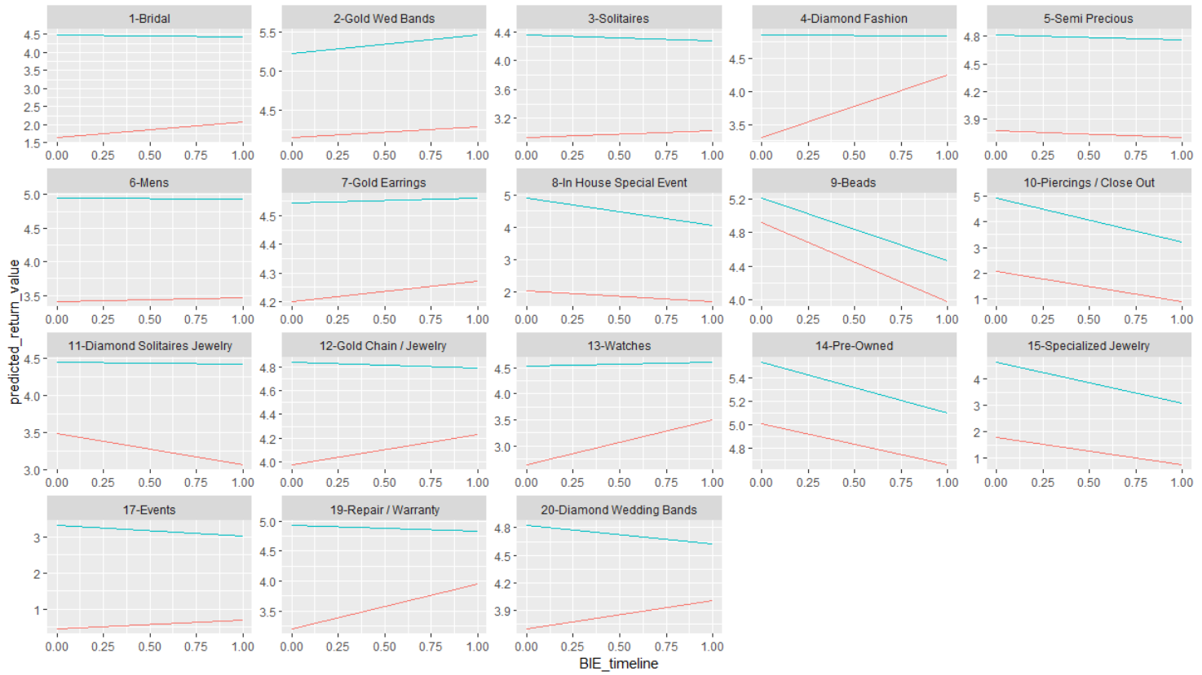
Online Returns – Product Level
Product Category | Increase/ Decrease
1 | -42.9%***
2 | +19.1%***
3 | -93.9%***
4 | -95%**
5 | -1.2%
6 | -1.7%
7 | -0.43
8 | NA
9 | -49.3%***
10 | NA
11 | +37.4%***
12 | -34.6%***
13 | -81.3%***
14 | -41.4%***
15 | NA
16 | NA
17 | NA
18 | NA
19 | NA
20 | -92.7%***
21 | -54.0%***

